Slide 1
Decision Tree Classification Algorithm:
Decision Tree is a Supervised learning technique that can be used for both classification and Regression problems.
It uses a flowchart like a tree structure.
It is a tree-structured classifier, where
Internal nodes represent the features of a dataset,
Branches represent the decision rules and
Leaf node represents the outcome.
Leaf nodes are the output of those decisions.
A decision tree is used for multi-dimensional analysis with multiple classes.

Slide 2
Each node (or decision node) of a decision tree corresponds to one of the feature vector.
The tree terminates at different leaf nodes (or terminal nodes) where each leaf node represents a possible value for the output variable.
Thus, a decision tree consists of three types of nodes:
Root Node
Branch Node
Leaf Node

Slide 3

Below diagram explains the general structure of a decision tree:

Slide 4
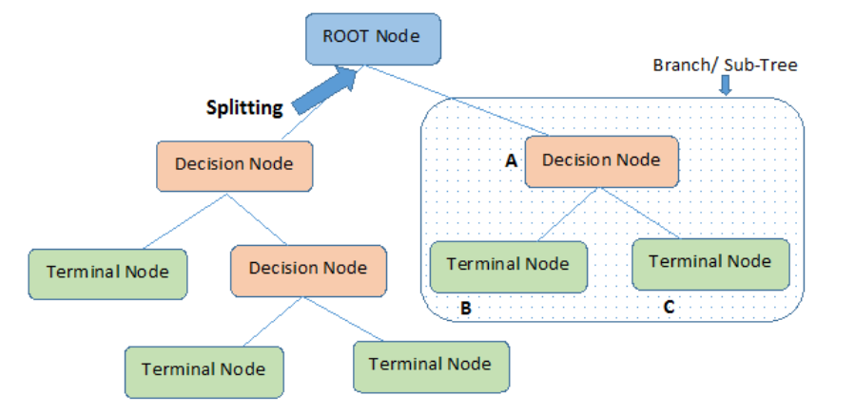

Slide 5
Decision Tree Terminologies:
Root Node: Root node is from where the decision tree starts. It represents the entire dataset, which further gets divided into two or more homogeneous sets.
Leaf Node: Leaf nodes are the final output node, and the tree cannot be segregated further after getting a leaf node.
Splitting: Splitting is the process of dividing the decision node/root node into sub-nodes according to the given conditions.
Branch/Sub Tree: A tree formed by splitting the tree.
Parent/Child node: The root node of the tree is called the parent node, and other nodes are called the child nodes.

Slide 6
What is overfitting in decision tree?
The decision tree algorithm, unless a stopping criterion is applied, may keep growing indefinitely – splitting for every feature and dividing into smaller partitions till the point that the data is perfectly classified.
This, as is quite evident, results in overfitting problem.
How to Avoid Overfitting?
To prevent a decision tree getting overfitted , pruning of the decision tree is essential.
Pruning reduces the size of the tree such that the model is more generalized and can classify unknown and unlabelled data in a better way.
Pruning: Pruning is the process of removing the unwanted branches from the tree.

Slide 7
There are two approaches of pruning:
Pre-pruning: Stop growing the tree before it reaches perfection.
Post-pruning: Allow the tree to grow entirely and then post-prune some of the branches from it.
In the case of pre-pruning, the tree is stopped from further growing once it reaches a certain number of decision nodes or decisions. Hence, in this strategy, the algorithm avoids overfitting as well as optimizes computational cost.
However, it also stands a chance to ignore important information contributed by a feature which was skipped, thereby resulting in miss out of certain patterns in the data.
On the other hand, in the case of post-pruning, the tree is allowed to grow to the full extent.
Then, by using certain pruning criterion, e.g. error rates at the nodes, the size of the tree is reduced.
This is a more effective approach in terms of classification accuracy as it considers all minute information available from the training data.
However, the computational cost is obviously more than that of pre-pruning.

Slide 8
Strengths of decision tree
It produces very simple understandable rules.
For smaller trees, not much mathematical and computational knowledge is required to understand this model.
Works well for most of the problems.
It can handle both numerical and categorical variables.
Can work well both with small and large training data sets.
Decision trees provide a definite clue of which features are more useful for classification.

Slide 9
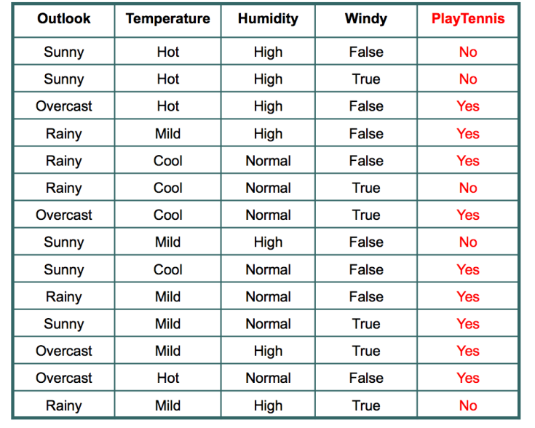
The independent variables are Outlook, Temperature, Humidity, and Wind. The dependent variable is whether to play football or not.
As the first step, we have to find the Root Node(parent node) for our decision tree. For that follow the steps:

Slide 10
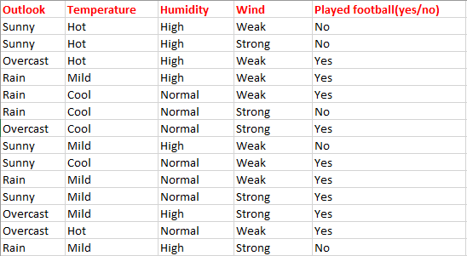

Slide 11
Entropy:
Entropy is a measure of randomness. In other words, its a measure of unpredictability.
In case of binary event(like the coin toss, where output can be either of the two events, head or tail) a mathematical face:
Entropy = -[probability(a) * log2(probability(a))] – [probability(b) * log2(probability(b))]
Where,
probability(a) is probability of getting head and
probability(b) is probability of getting tail.

Slide 12
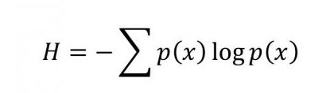
What is “Entropy”? and What is its function?
In machine learning, entropy is a measure of the randomness in the information being processed.
The higher the entropy, the harder it is to draw any conclusions from that information.
It is a measure of the amount of uncertainty in a data set.
Entropy controls how a Decision Tree decides to split the data. It actually affects how a Decision Tree draws its boundaries.

Slide 13

Example:- Given the set S = {a, a, a, b, b, b, b, b}
Total intances: 8
Instances of b: 5
Instances of a: 3

Slide 14
= [ -3/8*log2(3/8) - 5/8*log2(5/8)]
= [ -0.375 * (-1.415) - 0.625 * (-0.678)]
= (0.530+0.424)
= 0.954 bits

Slide 15
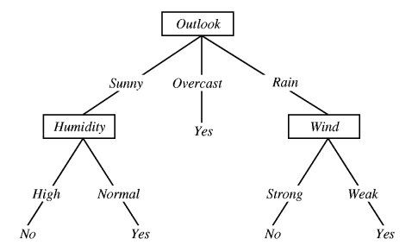
Information Gain
In the decision tree shown here:

Slide 16
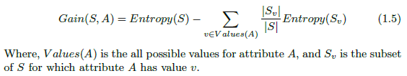
Information Gain:
The measure we will use called information gain, is simply the expected reduction in entropy caused by partitioning the data set according to this attribute.
The information gain (Gain(S,A)) of an attribute A relative to a collection of data set S, is defined as-

Slide 17
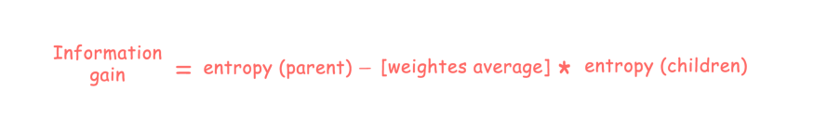
Information gain is used for determining the best features/attributes that render maximum information about a class.
It follows the concept of entropy while aiming at decreasing the level of entropy, beginning from the root node to the leaf nodes.
Information gain computes the difference between entropy before and after split and specifies the impurity in class elements.
Information Gain = Entropy before splitting - Entropy after splitting

Slide 18

The expected information needed to classify a tuple in D is given by
Information gain is calculated by comparing the entropy of the dataset before and after a transformation.
where pi is the nonzero probability that an arbitrary tuple in D belongs to class Ci and is estimated by | Ci , D |/ |D |.
A log function to the base 2 is used, because the information is encoded in bits.
Info(D) is also known as the entropy of D.

Slide 19

How much more information would we still need (after the partitioning) to arrive at an exact classification?
This amount is measured by
The term | Dj |/ |D| acts as the weight of the jth partition.
InfoA(D) is the expected information required to classify a tuple from D based on the partitioning by A.
The smaller the expected information (still) required, the greater the purity of the partitions.

Slide 20
Information gain is defined as the difference between the original information requirement and the new requirement (i.e., obtained after partitioning on A).
It is given by
In other words, Gain(A) tells us how much would be gained by branching on A.
It is the expected reduction in the information requirement caused by knowing the value of A.
The attribute A with the highest information gain, Gain(A), is chosen as the splitting attribute at node N.

Slide 21
Table 8.1 Class-Labeled Training Tuples
RID | Age | income | student | Credit_rating | Class: buys_computer
1 | Youth | High | No | Fair | No
2 | Youth | High | No | Excellent | No
3 | Middle_aged | High | No | Fair | Yes
4 | Senior | Medium | No | Fair | Yes
5 | Senior | Low | Yes | Fair | Yes
6 | Senior | Low | Yes | Excellent | No
7 | Middle_aged | Low | Yes | Excellent | Yes
8 | Youth | Medium | No | Fair | No
9 | Youth | low | Yes | Fair | Yes
10 | Senior | Medium | Yes | Fair | Yes
11 | youth | Medium | Yes | Excellent | Yes
12 | Middle_aged | Medium | No | Excellent | Yes
13 | Middle_aged | High | Yes | Fair | Yes
14 | senior | medium | No | Excellent | No

Slide 22
Example 8.1 Induction of a decision tree using information gain.
Solution: Table 8.1 presents a training set, D.
In this example, each attribute is discrete valued.
( Continuous-valued attributes have been generalized.)
The class label attribute, buys computer, has two distinct values (namely, {yes, no}) ;
therefore, there are two distinct classes (i.e., m=2).
Let class C1 correspond to yes and class C2 correspond to no.

Slide 23

There are 9 tuples of class yes and 5 tuples of class no.
A (root) node N is created for the tuples in D.
To find the splitting criterion for these tuples, we must compute the information gain of each attribute.
We first use Eq. (8.1) to compute the expected information needed to classify a tuple in D:

Slide 24
Next, we need to compute the expected information requirement for each attribute.
Let’s start with the attribute age. We need to look at the distribution of yes and no tuples for each category of age.
For the age category “youth,” there are 2 yes tuples and 3 no tuples.
For the category “middle aged,” there are 4 yes tuples and 0 no tuples.
For the category “senior,” there are 3 yes tuples and 2 no tuples.

Slide 25




Using Eq. (8.2), the expected information needed to classify a tuple in D if the tuples are partitioned according to age is,
= 0.694
Hence, the gain in information from such a partitioning would be,
= 0.940-0.694
= 0.246 bits

Slide 26
Next, we need to compute the expected information requirement for the attribute Income.
We need to look at the distribution of yes and no tuples for each category of age.
For the income category “High ,” there are 2 yes tuples and 2 no tuples.
For the income category “Medium,” there are 4 yes tuples and 2 no tuples.
For the category “Low ,” there are 3 yes tuples and 1 no tuples.

Slide 27
Using Eq. (8.2), the expected information needed to classify a tuple in D if the tuples are partitioned according to income is,
Entropy(income(D))=(4/14)*[-2/4*log(2/4)-2/4*log(2/4)+(6/14)*[-4/6*log(4/6)-2/6*log(2/6)] + (4/14)*[-3/4*log(3/4)- ¼ *log(1/4)]
=(4/14)*[(-0.5*-1.0+-0.5* 1.0)]+(6/14)*[(0.666*0.5849)+(0.3333*1.5851)]+ (4/14)*[(0.75*0.4150) + (0.25*2.0)]
=(2/7)*[0.5+0.5]+(3/7)*[(0.666*0.5849)+(0.3333*1.5851)]+ (2/7)*[(0.75*0.4150) + (0.25*2.0)]
= 0.2857*[1.0] + 0.4285*[0.38954+0.5283]+ 0.2857*[0.31125+0.5]
= 0.2857+0.3934+ 0.2317
= 0.9108
Hence, the gain in information from such a partitioning would be,
Gain(income)= Info(D)- Info(income)(D)
= 0.940-0.9108
= 0.029 bits ------------------(8.1)

Slide 28
Next, we need to compute the expected information requirement for the attribute Student.
We need to look at the distribution of yes and no tuples for each category of student.
For the student category “Yes ,” there are 6 yes tuples and 1 no tuples.
For the student category “No,” there are 3 yes tuples and 4 no tuples.

Slide 29
Using Eq. (8.2), the expected information needed to classify a tuple in D if the tuples are partitioned according to student is,
Info(student)(D)=(7/14)*[-6/7*log(6/7)-1/7*log(1/7)+(7/14)*[-3/7*log(3/7)-4/7*log(4/7)]
= (7/14)*[0.8571*(0.2224)+(0.1428*2.8079)+(7/14)*[0.4285*1.2226 -0.5714*0.8074)]
= (7/14)*[0.8571*(0.2224)+(0.1428*2.8079)+(7/14)*[0.4285*1.2226 -0.5714*0.8074)]
= 0.5*(0.1906+0.4009)+0.5*(0.5238+0.4613)
=0.2957+0.4925
=0.7880
Hence, the gain in information from such a partitioning would be,
Gain(student) = 0.940-0.788
= 0.152 bits

Slide 30
Similarly, we can compute Gain(credit_rating)= 0.048 bits.
Because age has the highest information gain among the attributes, it is selected as the splitting attribute.
Node N is labeled with age, and branches are grown for each of the attribute’s values.
The tuples are then partitioned accordingly, as shown in Figure 8.5.
Notice that the tuples falling into the partition for age=middle_aged all belong to the same class. Because they all belong to class “yes,” a leaf should therefore be created at the end of this branch and labeled “yes.”
The final decision tree returned by the algorithm was shown earlier in Figure 8.2.

Slide 31
Step 1: Calculate the Entropy of one attribute — Prediction: Clare Will Play Tennis/ Not Play Tennis
For this illustration, I will use this contingency table to calculate the entropy of our target variable: Played? (Yes/No).
There are 14 observations (10 “Yes” and 4 “No”).
The probability (p) of ‘Yes’ is 0.71428(10/14), and the probability of ‘No’ is 0.28571 (4/14).
You can then calculate the entropy of our target variable using the equation above.

Slide 32
Step 2: Calculate the Entropy for each feature using the contingency table
To illustrate, I use Outlook as an example to explain how to calculate its Entropy. There are a total of 14 observations. Summing across the rows we can see there are 5 of them belong to Sunny, 4 belong to Overcast, and 5 belong to Rainy. Therefore, we can find the probability of Sunny, Overcast, and Rainy and then calculate their entropy one by one using the above equation. The calculation steps are shown below.

Slide 33
Definition: Information Gain is the decrease or increase in Entropy value when the node is split.
The equation of Information Gain:
Information Gain from X on Y.

Slide 34
Step 3: Choose attribute with the largest Information Gain as the Root Node
The information gain of ‘Humidity’ is the highest at 0.918. Humidity is the root node.
Step 4: A branch with an entropy of 0 is a leaf node, while a branch with entropy more than 0 needs further splitting.
Step 5: Nodes are grown recursively in the ID3 algorithm until all data is classified.

Slide 35
We decided to break the first decision on the basis of outlook. We could have our first decision based on humidity or wind but we chose outlook. Why?
Because making our decision on the basis of outlook reduced our randomness in the outcome(which is whether to play or not), more than what it would have been reduced in case of humidity or wind.
Let’s understand with the example here.
Please refer to the play tennis dataset that is pasted above.

Slide 36
What is a good quantitative measure of the worth of an attribute? Information gain measures how well a given attribute separates the training examples according to their target classification. ID3 uses this information gain measure to select among the candidate attributes at each step while growing the tree.
Information Gain is based on Entropy

Slide 38
We have data for 14 days. We have only two outcomes :
Either we played tennis or we didn’t play.
In the given 14 days, we played tennis on 9 occasions and we did not play on 5 occasions.
Probability of playing tennis:
Number of favourable events : 9
Number of total events : 14
Probability = (Number of favourable events) / (Number of total events)
= 9/14
= 0.642

Slide 39
Now, we will see probability of not playing tennis.
Probability of not playing tennis:
Number of favourable events : 5
Number of total events : 14
Probability = (Number of favourable events) / (Number of total events)
=5/14
=0.357

Slide 40
Entropy at source= -(Probability of playing tennis) * log2(Probability of playing tennis) – (Probability of not playing tennis) * log2(Probability of not playing tennis)
E(S) = -[(9/14)log2(9/14) - (5/14)log2(5/14)]
= -0.652 * log2(0.652) – 0.357*log2(0.357)
=0.940
So, Entropy of whole system before we make our first question is 0.940
Note: Here typically we will take log to base 2

Slide 41
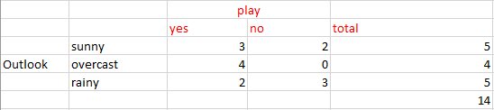
From the above data for outlook we can arrive at the following table easily:
Now we have to calculate average weighted entropy. ie, we have found the total of weights of each feature multiplied by probabilities.
Entropy among the three branches:
Entropy among three branches = ((number of sunny days)/(total days) * (entropy when sunny)) + ((number of overcast days)/(total days) * (entropy when overcast)) + ((number of rainy days)/(total days) * (entropy when rainy))

Slide 42
E(S, outlook) = (5/14)*E(3,2) + (4/14)*E(4,0) + (5/14)*E(2,3)
= ((5/14) * 0.971) +((4/14) * 0.0) +((5/14)*0.971)
= 0.693
Hence, the gain in information from such a partitioning would be,
Gain(S, Outlook)= E(S)- E(S, Outlook)
= 0.940-0.693
=0.247

Slide 43
Now we will calculate Information gain for Humidity:
Entropy among the three branches:
Entropy among three branches = ((number of High Humidity days)/(total days) * (entropy when High)) + ((number of Normal days)/(total days) * (entropy when Normal))
E(S, Humidity) = (7/14)*E(3,4) + (7/14)*E(6,1)
Humidity |  | Play
 |  | Yes | No | Total
 | High | 3 | 4 | 7
 | Normal | 6 | 1 | 7

Slide 44
= (7/14)*(-(3/7)log2(3/7)-(4/7)log2(4/7))+ (7/14)* (-(6/7)log2(6/7)-(1/7)log2(1/7))
=0.788
Hence, the gain in information from such a partitioning would be,
Gain(S, Humidity)= E(S)- E(S,Humidity)
= 0.940-0.788
=0.152

Slide 45
Information gain for Outlook, Temperature, Humidity, and Wind is as follows:
Outlook: Information Gain= 0.247
Humidity:Information Gain = 0.152
Windy: Information Gain = 0.048
Temperature: Information Gain = 0.029
Now select the feature having the largest Information gain.
Here it is Outlook. So it forms the first node(Root node) of our decision tree.

Slide 46
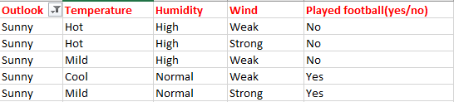
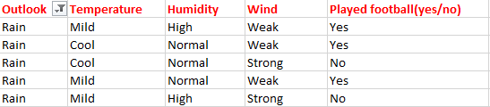

Slide 47
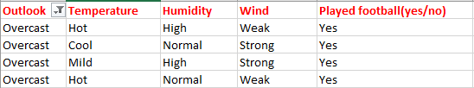
Since overcast contains only examples of class ‘Yes’ we can set it as yes. That means If outlook is overcast Tennis will be played. Now our decision tree looks as follows.

Slide 48
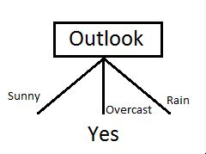
The next step is to find the next node in our decision tree.
Now we will find one under sunny.
Now, we have to determine which of the following Temperature, Humidity or Wind has higher information gain.

Slide 49
The next step is to find the next node in our decision tree. Now we will find one under sunny. We have to determine which of the following Temperature, Humidity or Wind has higher information gain.
Day | Outlook | Temp | Humidity | Wind | Class: Play Tennis?
D1 | Sunny | Hot | High | Weak | No
D2 | Sunny | Hot | High | Strong | No
D8 | Sunny | Mild | High | Weak | No
D9 | Sunny | Cool | Normal | Weak | Yes
D11 | Sunny | Mild | Normal | Strong | Yes

Slide 50
ID3 Algorithm
[D1,D2,…,D14]
[9+,5-]
Outlook
Sunny
Overcast
Rain
S_{sunny}=[D1,D2,D8,D9,D11]
[2+,3-]
[D3,D7,D12,D13]
[4+,0-]
[D4,D5,D6,D10,D14]
[3+,2-]
Humidity
Yes
?
Test for this node
High
Normal

Slide 51
Calculate parent entropy E(sunny)
E(sunny) = -(2/5)log(2/5)-(3/5)log(3/5)
= -( 0.4)*(-1.3219)-(0.6)*(-0.7369)
= 0.5287+0.4421
= 0.971
Now Calculate the information gain of Humidity, Wind and Temperature.
IG(sunny, Temperature)

Slide 52
Sunny | Humidity |  | Play Tennis?
 |  |  | Yes | No | Total
 |  | High | 0 | 3 | 3
 |  | Normal | 2 | 0 | 2
 |  |  |  |  | 5
E(Sunny, Humidity)=(3/5)*E(0,3)+(2/5)*E(2,0)
=(3/5)*0+(2/5)*0
=0
IG(Sunny, Humidity)=E(S)- E(Sunny, Humidity)
= 0.971-0
= 0.971
For humidity from the above table, we can say that play will occur if humidity is normal and will not occur if it is high. Similarly, find the nodes under rainy.

Slide 53
 |  |  | Play Tennis?
 |  |  | Yes | No | Total
Sunny | Temp. | Hot | 0 | 2 | 2
 |  | Mild | 1 | 1 | 2
 |  | Cool | 1 | 0 | 1
 |  |  |  |  | 5
E(Sunny, Temperature)=(2/5)*E(0,2)+(2/5)*E(1,1)+(1/5)*E(1,0)
=(2/5)*0+(2/5)*(-(1/2)log1/2-(1/2)log1/2)+ (1/5)*0
=0+(2/5)*1.0+0= 0.40
IG(Sunny, Temp.)=E(S)- E(Sunny, Temperature)
= 0.971-0.40
= 0.571

Slide 54
 |  |  | Class: Play Tennis?
 |  |  | Yes | No | Total
Sunny | Wind | Strong | 1 | 1 | 2
 |  | Weak | 1 | 2 | 3
 |  |  |  |  | 5
E(Sunny, Wind)=(2/5)*E(1,1)+(3/5)*E(1,2)
=(2/5)*(-(1/2)log(1/2)-(1/2)log(1/2)+ (3/5)*(-(1/3)log1/3-(2/3)log2/3)
=0.4*[0.5(-1)+(0.5)(-1)]+0.6[-0.3333*(-1.5851)-0.6666*(-0.585)]
=0.4*1.0+0.6 *[0.5278+0.3896]
=0.4+0.6*0.9174
=0.4+0.5504
=0.9504
IG(Sunny, Wind)=E(S)- E(Sunny, Wind)
= 0.971-0.9504
= 0.020

Slide 55
Day | Outlook | Temp | Humidity | Wind | Class: Play Tennis?
D4 | Rain | Mild | High | Weak | Yes
D5 | Rain | Cool | Normal | Weak | Yes
D6 | Rain | Cool | Normal | Strong | No
D10 | Rain | Mild | Normal | Weak | Yes
D14 | Rain | Mild | High | Strong | No
E(Rain)=E(3,2)
= (-3/5)*log3/5-(2/5)log(2/5)
=0.6*0.7369+0.4*1.3219
=0.970
Now Calculate the information gain of Humidity, Wind and Temperature.

Slide 56
Outlook | Rain | Humidity | Yes | No | Total
 |  | High | 1 | 1 | 2
 |  | Normal | 2 | 1 | 3
 |  | Total |  |  | 5
E(Rain , Humidity)=(2/5)*E(1,1)+(3/5)*E(2,1)
=(2/5)*(-(1/2)log1/2-(1/2)log1/2+(3/5)*(-(2/3)log2/3-(1/3)log1/3
=0.4*((0.5*-1)+(0.5*1)+0.6*(0.666*0.5851+0.333*1.5851)
=0.4*1.0+0.6*(0.3900+0.5283)
=0.4+0.5509
=0.950
IG(Rain, Humidity)=E(S)- E(Rain, Humidity)
= 0.970-0.950
= 0.020

Slide 57
Day | Outlook | Wind |  |  | Total
D4 | Rain | Weak |  |  | Yes
D5 | Rain | Weak |  |  | Yes
D6 | Rain | Strong |  |  | No
D10 | Rain | Weak |  |  | Yes
D14 | Rain | Strong |  |  | No
E(Rain , Wind)=(2/5)*E(1,1)+(3/5)*E(2,1)
=(2/5)*(-(1/2)log1/2-(1/2)log1/2+(3/5)*(-(2/3)log2/3-(1/3)log1/3
=0.4*((0.5*-1)+(0.5*1)+0.6*(0.666*0.5851+0.333*1.5851)
=0.4*1.0+0.6*(0.3900+0.5283)
=0.4+0.5509
=0.950
IG(Rain, Wind)=E(S)- E(Rain, Wind)
= 0.970-0.950
= 0.020

Slide 58
Day | Outlook | Temp | Humidity | Wind | Class: Play Tennis?
D4 | Rain | Mild | High | Weak | Yes
D5 | Rain | Cool | Normal | Weak | Yes
D6 | Rain | Cool | Normal | Strong | No
D10 | Rain | Mild | Normal | Weak | Yes
D14 | Rain | Mild | High | Strong | No

Slide 59
ID3 Algorithm
[D1,D2,…,D14]
[9+,5-]
Outlook
Sunny
Overcast
Rain
S_{sunny}=[D1,D2,D8,D9,D11]
[2+,3-]
[D3,D7,D12,D13]
[4+,0-]
[D4,D5,D6,D10,D14]
[3+,2-]
?
Yes
?
Test for this node
Gain(S_{sunny} , Humidity)=0.970-(3/5)0.0 – 2/5(0.0) = 0.970
Gain(S_{sunny} , Temp.)=0.970-(2/5)0.0 –2/5(1.0)-(1/5)0.0 = 0.570
Gain(S_{sunny} , Wind)=0.970= -(2/5)1.0 – 3/5(0.918) = 0.019

Slide 60
Day | Outlook | Temp | Humidity | Wind | Class: Play Tennis?
D1 | Sunny | Hot | High | Weak | No
D2 | Sunny | Hot | High | Strong | No
D3 | Overcast | Hot | High | Weak | Yes
D4 | Rain | Mild | High | Weak | Yes
D5 | Rain | Cool | Normal | Weak | Yes
D6 | Rain | Cool | Normal | Strong | No
D7 | Overcast | Cool | Normal | Strong | Yes
D8 | Sunny | Mild | High | Weak | No
D9 | Sunny | Cool | Normal | Weak | Yes
D10 | Rain | Mild | Normal | Weak | Yes
D11 | Sunny | Mild | Normal | Strong | Yes
D12 | Overcast | Mild | High | Strong | Yes
D13 | Overcast | Hot | Normal | Weak | Yes
D14 | Rain | Mild | High | Strong | No

Slide 61
Outlook: Information Gain=
Humidity:Information Gain = 0.152
Windy: Information Gain = 0.048
Temperature: Information Gain = 0.029

